Slide 1
Rounds
Ted Rau
ted@sociocracyforall.org
Webchat: Rounds
Notes:
-

Slide 2
Overview
Who am I?
What? Why rounds? And what is it?
Let’s try it!
Let’s make them even better

Slide 3
Who am I?
Pioneer Valley Cohousing since 2012
Op leader of

Slide 4
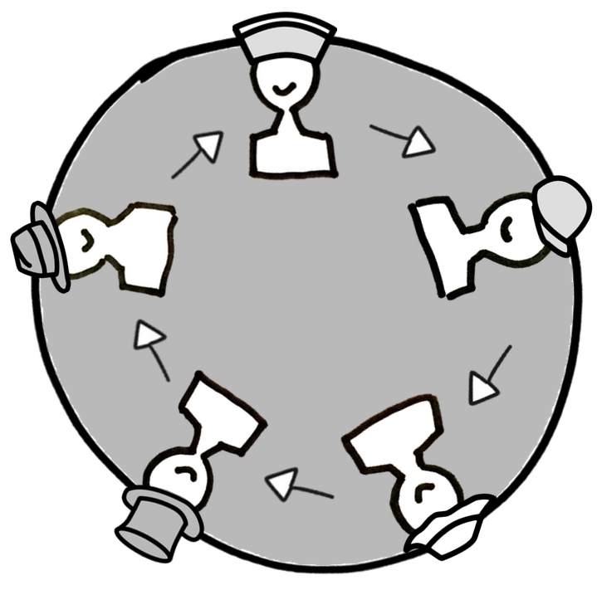
What is it?

Slide 5
Why rounds
equivalence
clarity/structure
saves time
When rounds
small groups
ideally when people can contribute

Slide 6
Kinds of rounds
Clarifying questions round
ask in a round
answer immediately or at the end

Slide 7
Kinds of rounds
Clarifying questions round
ask in a round
answer immediately or at the end
Reaction round
1-2 rounds, then shift
keep it brief

Slide 8
Kinds of rounds
Clarifying questions round
ask in a round
answer immediately or at the end
Reaction round
1-2 rounds, then shift
keep it brief
Consent round
two options: consent/object
finish round when there are objections

Slide 9
Let’s try it!
Clarifying questions?
Reaction round
Consent round

Slide 10
What you can do:
Encouraging rounds
“I’d really like to make sure everyone can speak without being interrupted – let’s do a round so everyone can say what they want to say.”
“I have things I want to say but I don’t want to interrupt others. It’s easier for me to contribute if we do rounds.”

Slide 11
Making them even better
Keeping rounds short and sweet
model passing
time rounds (based on agreement, not punitive)
encourage people to take notes

Slide 12
The role of the facilitator
Separate facilitator voice from member voice
Put yourself in the middle of the round
Context
“as facilitator…”
“speaking as member…”

Slide 13
Learning more
Article “On rounds” http://ow.ly/IhGD50uIpFf
Article “The myth of natural flow” https://medium.com/@TedRau/the-myth-of-natural-flow-98f460128149
Article “How decision-making affects our behavior”
https://medium.com/@TedRau/how-decision-making-affects-our-behavior-74ecbc771b36
Tools using rounds – self-learning for groups interested in Dynamic Governance (sociocracy): www.sociocracyforall.org/elc
→ Drop your email in the chat if you want to receive links by email.

